Slide 1
Magic Beans By: Nick Bolles, Alex Laurent, rich Sanchez & Topher Witt
Latex editor plugin for NetBeans

Slide 2
Requirements
A button in Netbeans that opens our plugin
Ability to edit within the actual Netbeans IDE (Not a separate window)
Ability to edit text
Ability to save .bib files
Ability to export PDF’s

Slide 3
Approach
Taking an Agile approach
Heavy research to understand Netbeans Architecture, and how to incorporate Latex
Discovering and incorporating similar applications into our design process

Slide 4
The Timeline
Research
Development
Testing
wk1
wk2
wk3
wk4
wk5
wk6
wk7
wk8
wk9
wk10
wk11
wk12
Sept 20
Dec 5

Slide 5
Development Timeline
Build a plugin with button integrated into Netbeans interface that opens frame within Netbeans
Get .bib files to save and review requirements and begin testing
Exporting and outline view capability
wk1
wk2
wk3
wk4
wk5
Using open Latex, move the text editing capabilities into the plugin window
Integrate PDF saving

Slide 6
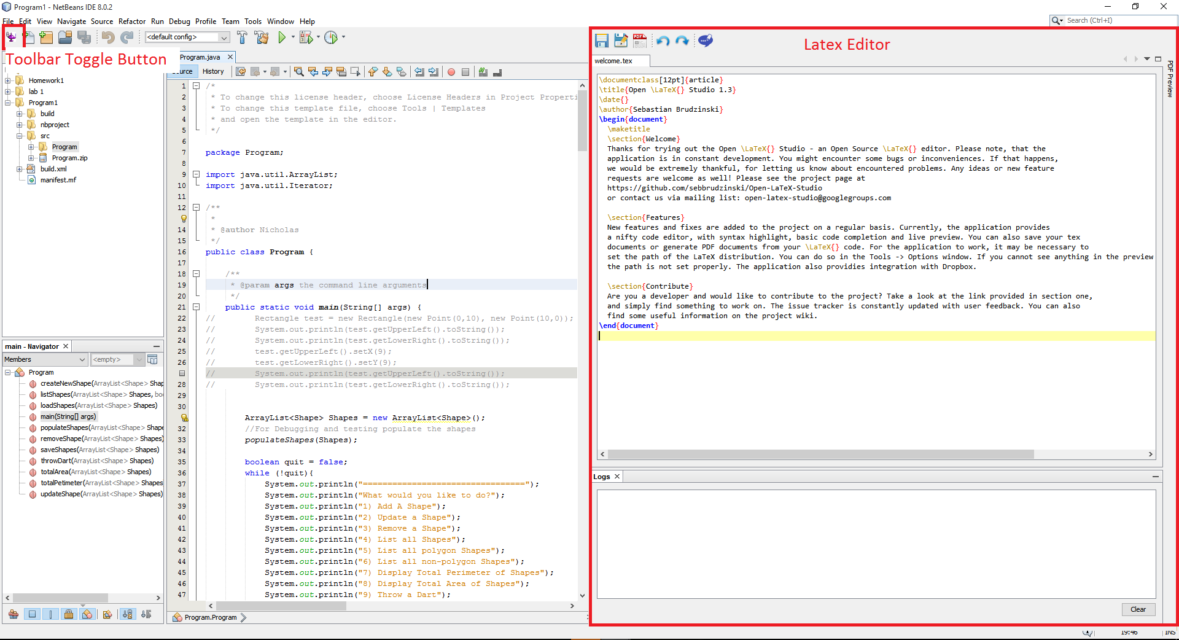
Visual Representation

